Slide 1
Clustering
Machine Learning

Slide 2
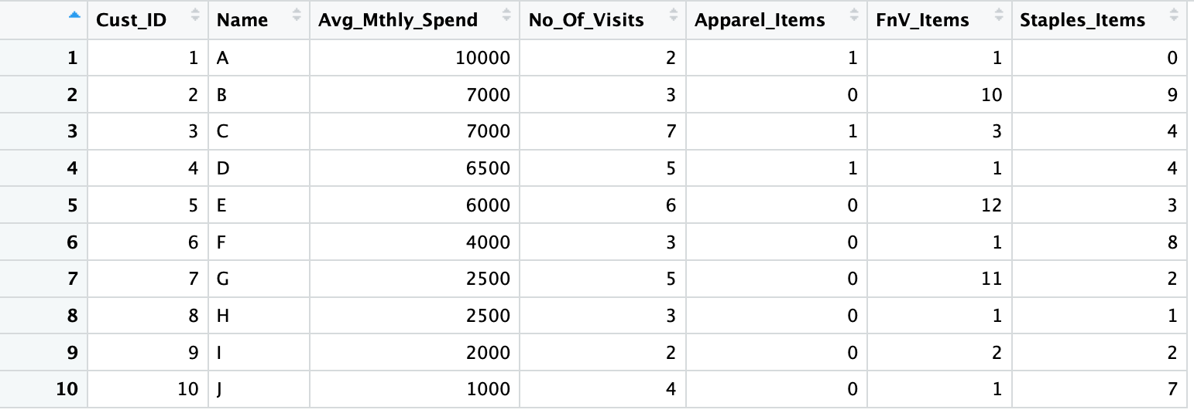
Data we will work with
  Customer Spend Data
    AVG_Mthly_Spend: The average monthly amount spent by customer
    No_of_Visits: The number of times a customer visited in a month
    Item Counts: Count of Apparel, Fruits and Vegetable, Staple Items purchased
  Can we cluster similar customers together?

Slide 3
Connectivity Based: Hierarchical Clustering
Hierarchical Clustering techniques create clusters in a hierarchical tree like structure
Any type of distance measure can be used as a measure of similarity
Cluster tree like output is called Dendogram
Techniques either start with individual objects and sequentially combine them (Agglomerative ), or start from one cluster of all objects and sequentially divide them (Divisive)

Slide 4
Agglomerative
Starts with each object as a cluster of one record each
Sequentially merges 2 closest records by distance as a measure of similarity to form a cluster.
How would we measure distance between two clusters?

Slide 5
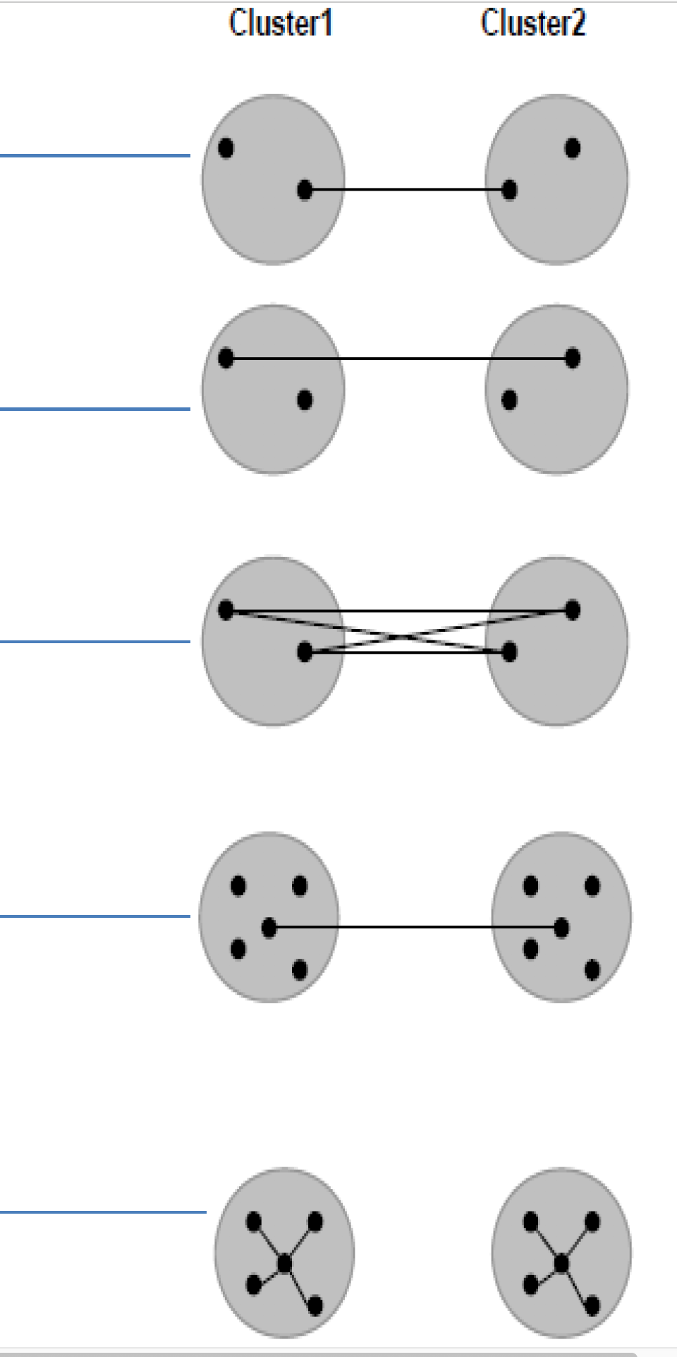
Distance between clusters
Single linkage – Minimum distance or Nearest neighbor
Complete linkage – Maximum distance or Farthest distance
Average linkage – Average of the distances between all pairs
Centroid method – combine cluster with minimum distance between the centroids of the two clusters
Ward’s method – Combine clusters with which the increase in within cluster variance is to the smallest degree

Slide 6
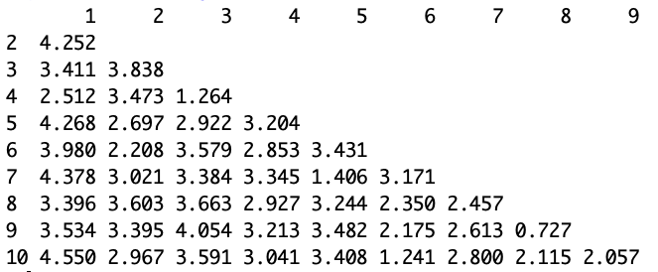
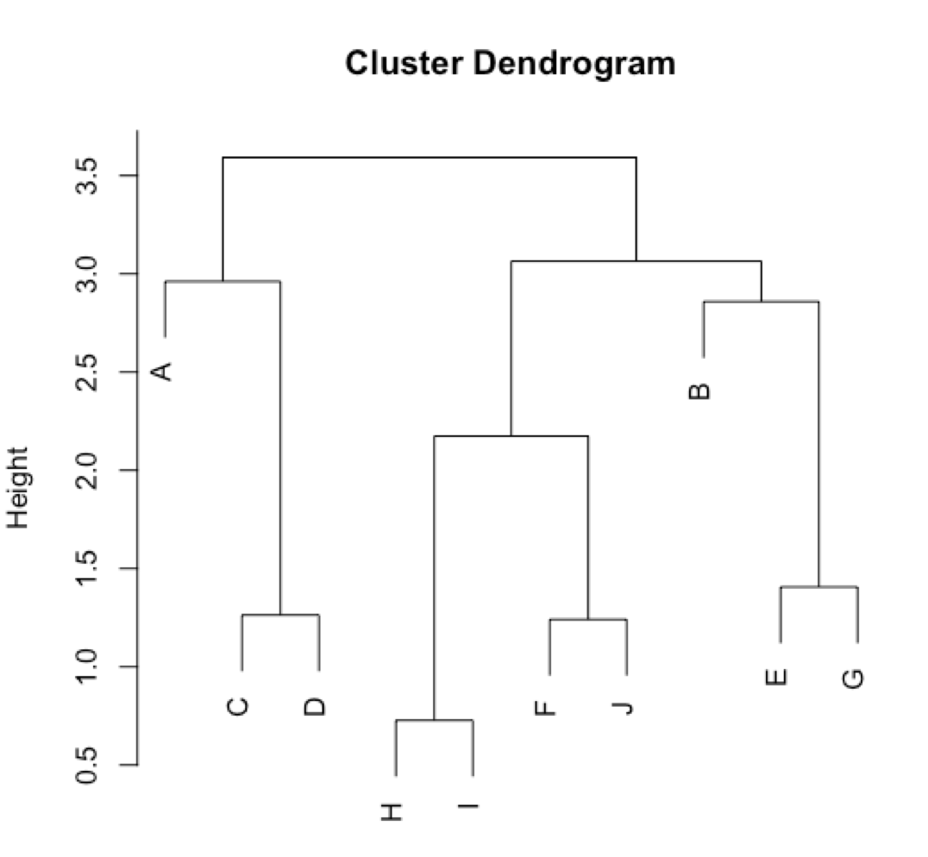
Distance between objects

Slide 7
Centroid based: K-Means Clustering
K-Means is probably the most used clustering technique
Aims to partition the n observations into k clusters so as to minimize the within-cluster sum of squares (i.e. variance).
Computationally less expensive compared to hierarchical techniques.
Have to pre-define K, the no of clusters

Slide 8
Lloyd’s algorithm
Assume K Centroids
Compute Squared Eucledian distance of each objects with these K centroids. Assign each to the closest centroid forming clusters.
Compute the new centroid (mean) of each cluster based on the objects assigned to each clusters.
Repeat 2 and 3 till convergence: usually defined as the point at which there is no movement of objects between clusters

Slide 9
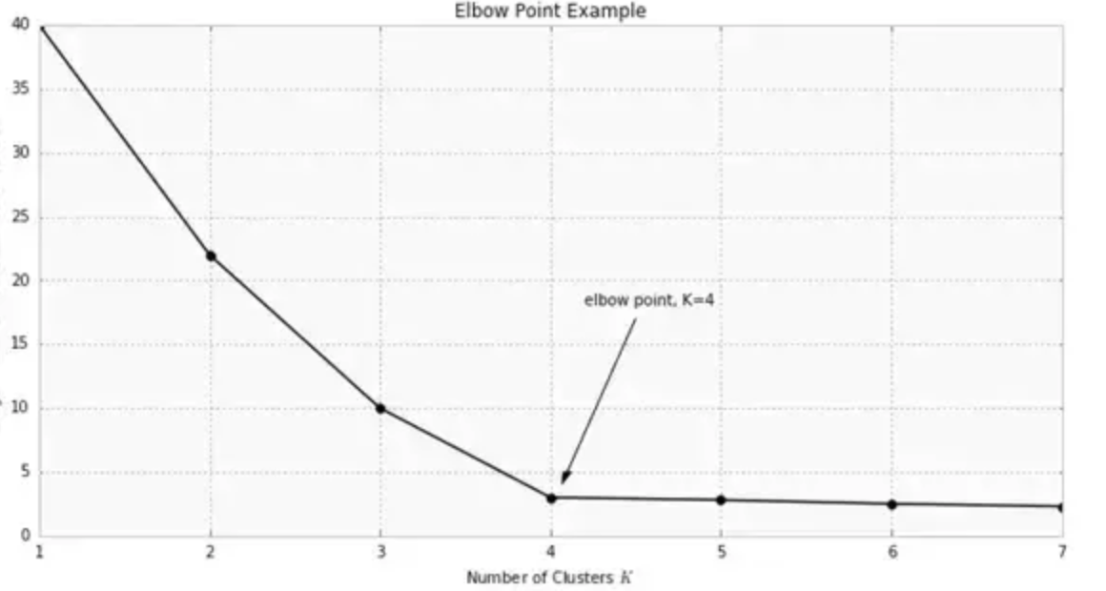
Choosing the optimal K
Usually subjective, based on striking a good balance between compression and accuracy
The “elbow” method is commonly used

Slide 10
Lloyd’s algorithm
Assume K Centroids
Compute Squared Eucledian distance of each objects with these K centroids. Assign each to the closest centroid forming clusters.
Compute the new centroid (mean) of each cluster based on the objects assigned to each clusters.
Repeat 2 and 3 till convergence: usually defined as the point at which there is no movement of objects between clusters

Slide 11
K-Means
Strengths | Weakness
Use simple principles without the need for any complex statistical terms | How to choose K?
Once clusters and their associated centroids are identified, it is easy to assign new objects (for example, new customers) to a cluster based on the object's distance from the closest centroid | The k-means algorithm is sensitive to the starting positions of the initial centroid. Thus, it is important to rerun the k-means analysis several times for a particular value of k to ensure the cluster results provide the overall minimum WSS
Because the method is unsupervised, using k-means helps to eliminate subjectivity from the analysis. | Susceptible to curse of dimensionality

Slide 12
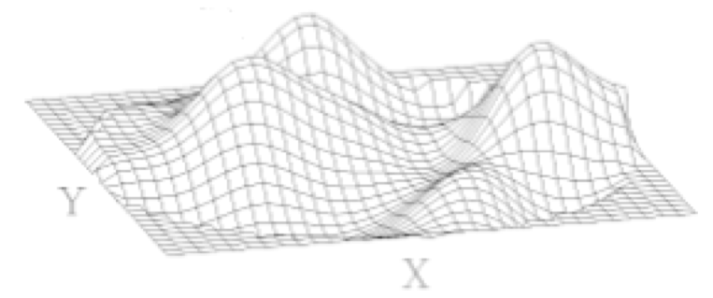
Visual Analysis of Clustering
Visual analysis of the attributes selected for the clustering may given an idea of the range of values that K should be evaluated in
Identifying the attributes on which clusters are clearly demarcated and using them in incremental order to build the multi-dimensional clusters likely to give much better clusters than using all the attributes at one go

Slide 13
Dynamic Clustering
Clustering on correct attributes is the key to good clustering results.
We can also consider those attributes who's value changes with time. For e.g. age, income category, years of work experience etc.
We can use sequential k means clustering over time to track individual clusters (how they change in size, shape and position
We can also understand how individual data points move across clusters, form new clusters etc.
Analyzing the changes in the clusters over time using metrics such as
Cluster size, new entries and exits one can analyze the impact of strategies designed based on earlier clustering analysis

